Slide 1

Project Management: Achieving Competitive Advantage
Fifth Edition
Chapter 9
Project Scheduling: Networks, Duration Estimation, and Critical Path
Copyright © 2019, 2016, 2013 Pearson Education, Inc. All Rights Reserved
Notes:
If this PowerPoint presentation contains mathematical equations, you may need to check that your computer has the following installed:
1) MathType Plugin
2) Math Player (free versions available)
3) NVDA Reader (free versions available)

Slide 2
Learning Objectives (1 of 2)
9.1 Understand the importance of project scheduling techniques.
9.2 Understand and apply key scheduling terminology.
9.3 Develop an activity network using Activity-on-Node (A O N) technique.
9.4 Perform activity duration estimation based on the use of probabilistic estimating techniques.

Slide 3
Learning Objectives (2 of 2)
9.5 Construct the critical path for a project schedule network using forward and backward passes, determine project slack, and calculate the probability of finishing on time.

Slide 4
P M B o K Core Concepts
Project Management Body of Knowledge (P M B o K) covered in this chapter includes:
Plan Schedule Management (P M B o K 6.1)
Define Activities (P M B o K 6.2)
Sequence Activities (P M B o K 6.3)
Estimate Activity Resources (P M B o K 6.4)
Estimate Activity Durations (P M B o K 6.5)
Develop Schedule (P M B o K 6.6)
Control Schedule (P M B o K 6.7)

Slide 5
Project Scheduling
Project scheduling requires us to follow some carefully laid-out steps, in order, for the schedule to take shape. P M B o K states, “an output of a schedule model that presents linked activities with planned dates, durations, milestones, and resources.”
Project planning, as it relates to the scheduling process, has been defined by the P M B o K as:
The identification of the project objectives and the ordered activity necessary to complete the project including the identification of resource types and quantities required to carry out each activity or task.

Slide 6
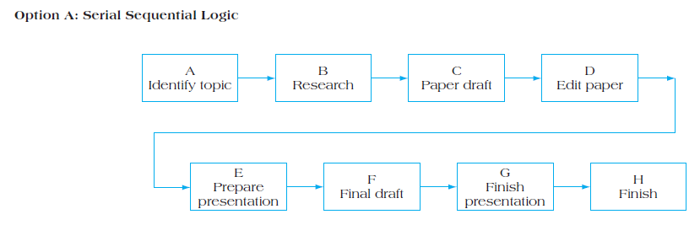
Network Diagram—Serial Sequential Logic
Figure 9.2A Alternative Activity Networks for Term Paper Assignment

Slide 7
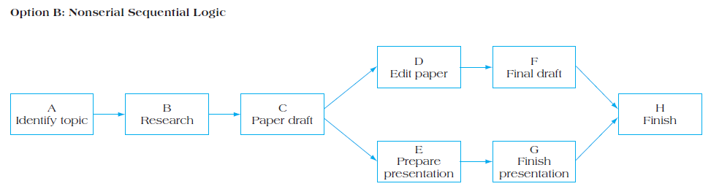
Network Diagram – Nonserial Sequential Logic
Figure 9.2B Alternative Activity Networks for Term Paper Assignment

Slide 8
Project Scheduling Terms (1 of 4)
Project Network Diagram: Any schematic display of the logical relationships of project activities.
Path: A sequence of activities defined by the project network logic.
Event: A point when an activity is either started or completed.
Node: One of the defining points of a network; a junction point joined to some or all of the other dependency lines (paths).

Slide 9
Project Scheduling Terms (2 of 4)
Predecessors: Those activities that must be completed prior to initiation of a later activity in the network.
Successors: Activities that cannot be started until previous activities have been completed. These activities follow predecessor tasks.
Early start (E S) date: The earliest possible date the uncompleted portions of an activity can start.
Late start (L S) date: The latest possible date that an activity may begin without delaying a specified milestone.

Slide 10
Project Scheduling Terms (3 of 4)
Forward pass: Network calculations to determine earliest start/earliest finish for an activity through working forward through each activity in network.
Backward pass: Network calculations to determine late start/late finish for uncompleted tasks through working backward through each activity in network.
Merge activity: An activity with two or more immediate predecessors.
Burst activity: An activity with two or more immediate successors.

Slide 11
Project Scheduling Terms (4 of 4)
Float: The amount of time an activity may be delayed from its early start without delaying the finish of the project.
Critical path: The path through project network with the longest duration.
Critical Path Method: A network analysis technique used to determine the amount of schedule flexibility on logical network paths in project schedule network and to determine minimum project duration.
Resource-limited schedule: Start and finish dates reflect expected resource availability.

Slide 12
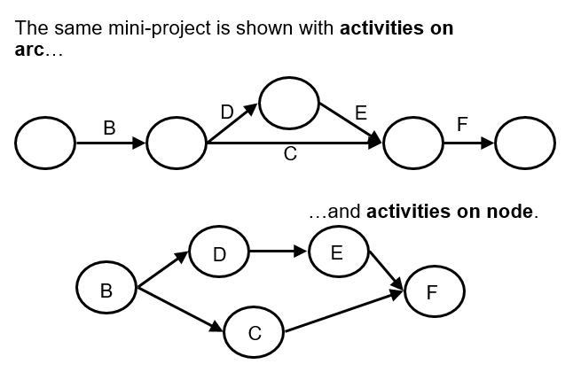
A O A Versus A O N

Slide 13
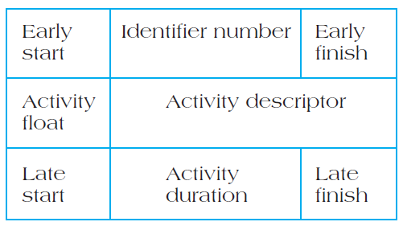
Node Labels
Figure 9.3 Labels for Activity Node

Slide 14

Serial Activities
Serial activities are those that flow from one to the next, in sequence.
Figure 9.5 Project Activities Linked in Series

Slide 15
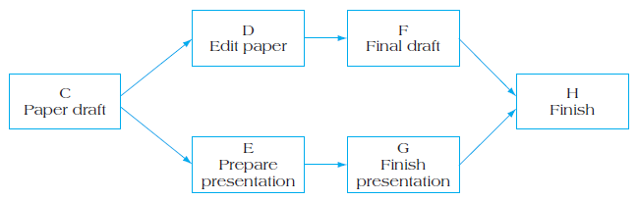
Concurrent Activities
When the nature of the work allows for more than one activity to be accomplished at the same time, these activities are called concurrent, and parallel project paths are constructed through the network.
Figure 9.6 Activities Linked in Parallel (Concurrent)

Slide 16
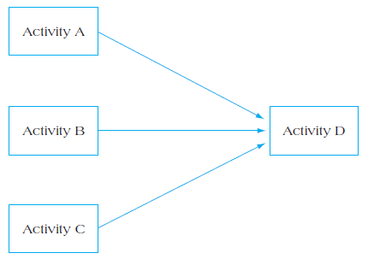
Figure 9.7 Merge Activity
Activity D can only begin following the completion of activities A, B, and C.

Slide 17
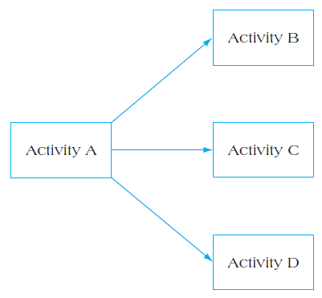
Figure 9.8 Burst Activity
Activities B, C, and D can only begin following the completion of activity A.

Slide 18
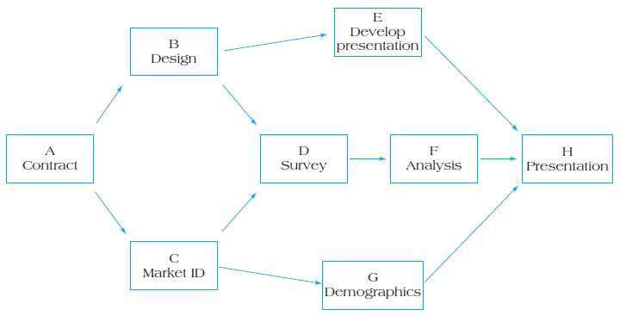
Complete Activity Network
Figure 9.10 Complete Activity Network for Project Delta

Slide 19
Duration Estimation Methods
Experience
Expert opinion
Mathematical derivation—Beta distribution
Most likely (m)
Most pessimistic (b)
Most optimistic (a)
Two assumptions used to convert m, a, and b into time estimates (T E) and variances

Slide 20
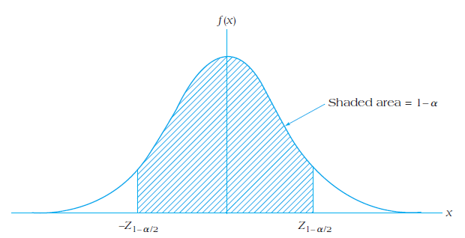
Figure 9.14 Symmetrical (Normal) Distribution for Activity Duration Estimation

Slide 21
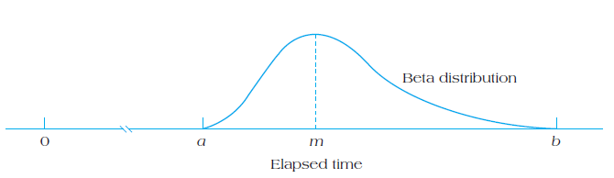
Figure 9.15 Asymmetrical (Beta) Distribution for Activity Duration Estimation

Slide 22
Activity Duration Estimates (1 of 2)
Table 9.2 Activity Duration Estimates for Project Delta
Name: Project Delta
Durations are listed in weeks
Activity | Description | Optimistic | Most Likely | Pessimistic
A | Contract signing | 3 | 4 | 11
B | Questionnaire design | 2 | 5 | 8
C | Target market I D | 3 | 6 | 9
D | Survey sample | 8 | 12 | 20
E | Develop presentation | 3 | 5 | 12
F | Analyze results | 2 | 4 | 7
G | Demographic analysis | 6 | 9 | 14
H | Presentation to client | 1 | 2 | 4

Slide 23
Activity Duration Estimates (2 of 2)
Table 9.3 Estimated Project Activity Times Using Beta Distribution
Name: Project Delta
Durations are listed in weeks
Activity | Description | T E start fraction left parenthesis 1:4:1 ration right parenthesis over 6
A | Contract signing | 5
B | Questionnaire design | 5
C | Target market I D | 6
D | Survey sample | 12.7
E | Develop presentation | 5.8
F | Analyze results | 4.2
G | Demographic analysis | 9.3
H | Presentation to client | 2.2

Slide 24
Constructing the Critical Path
Forward pass—an additive move through the network from start to finish
Backward pass—a subtractive move through the network from finish to start
Critical path—the longest path from end to end which determines the shortest project length

Slide 25
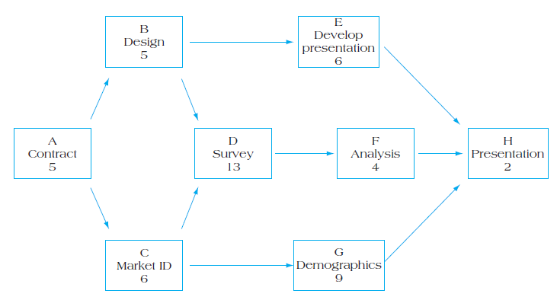
Figure 9.16 Partial Project Activity Network with Task Durations

Slide 26
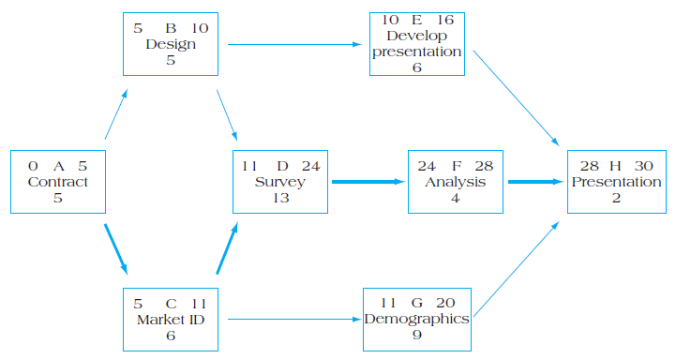
Figure 9.18 Activity Network with Forward Pass

Slide 27
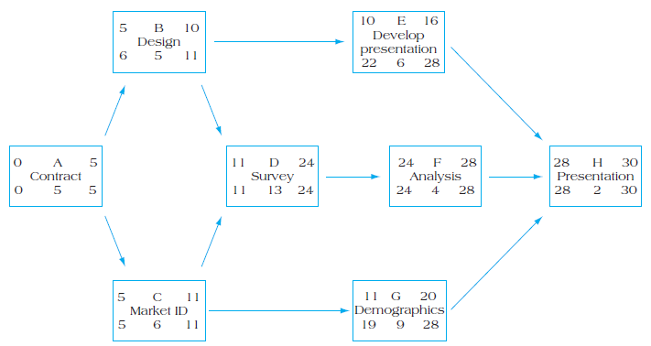
Figure 9.19 Activity Network with Backward Pass

Slide 28
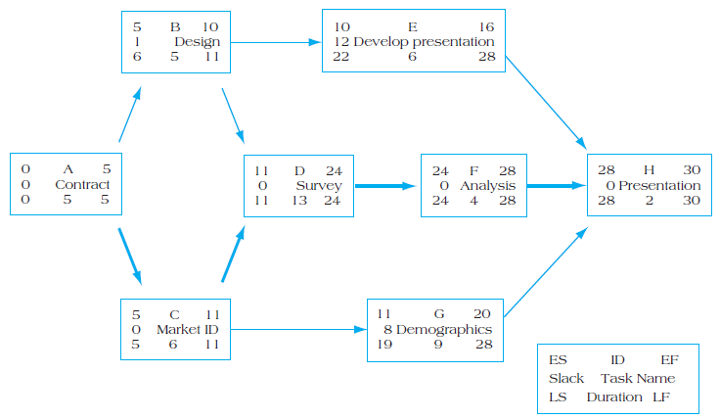
Figure 9.20 Project Network with Activity Slack and Critical Path

Slide 29
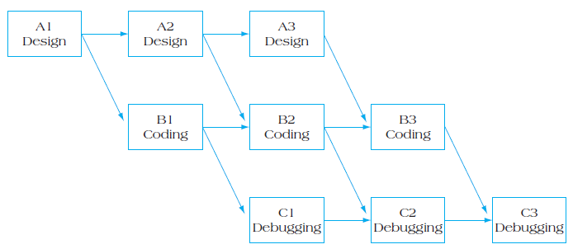
Figure 9.24 A O N Network with Laddering Effect

Slide 30
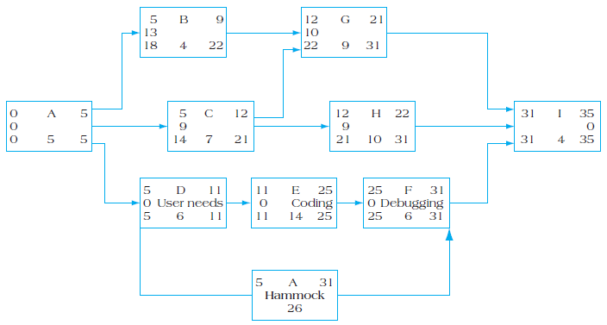
Figure 9.25 Example of a Hammock Activity

Slide 31
Options for Reducing the Critical Path
Eliminate tasks on the critical path.
Replan serial paths to be in parallel.
Overlap sequential tasks.
Shorten the duration on critical path tasks.
Shorten early tasks.
Shorten longest tasks.
Shorten easiest tasks.
Shorten tasks that cost the least to speed up.

Slide 32
Summary (1 of 2)
Understand the importance of project scheduling techniques.
Understand and apply key scheduling terminology.
Develop an activity network using Activity-on-Node (A O N) technique.
Perform activity duration estimation based on the use of probabilistic estimating techniques.

Slide 33
Summary (2 of 2)
Construct the critical path for a project schedule network using forward and backward passes, determine project slack, and calculate the probability of finishing on time.

Slide 34

Copyright

